Slide 1
Experimental Setup of Sound Emitting and Processing Robot for Acoustic-Based SLAM Applications
Final Presentation
Semester Project at LCAV
Ecole Polytechique Fédérale de Lausanne
Frederike Dümbgen 11.01.2016

Slide 2
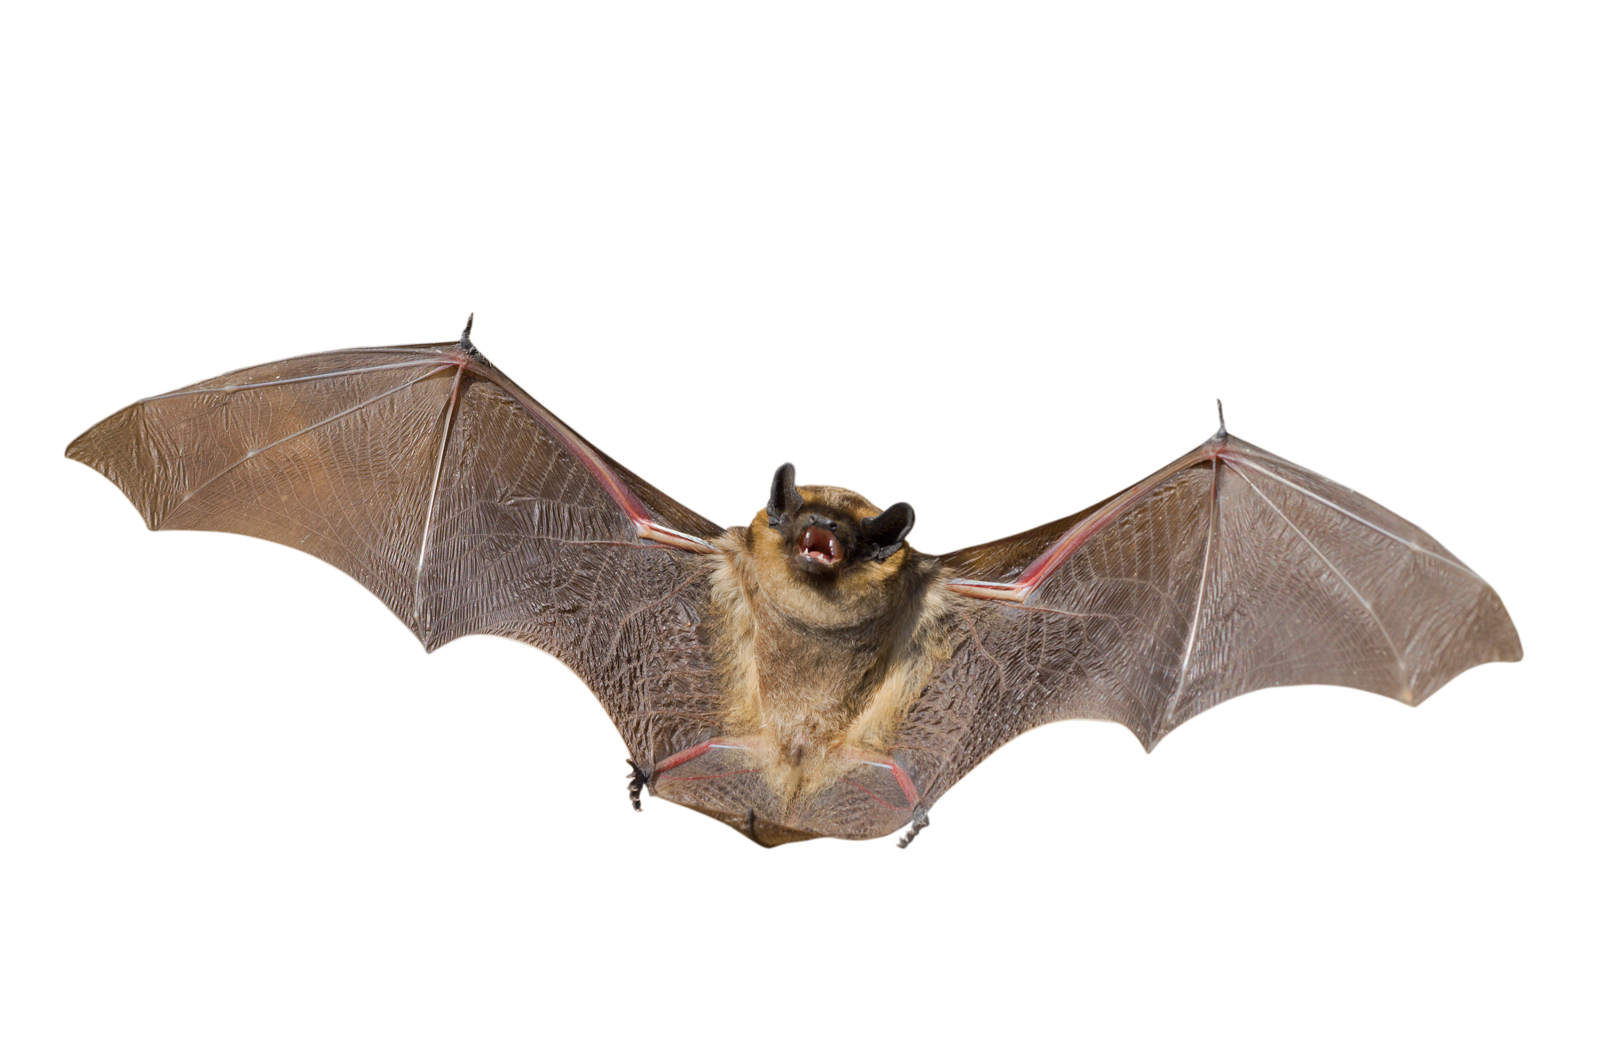
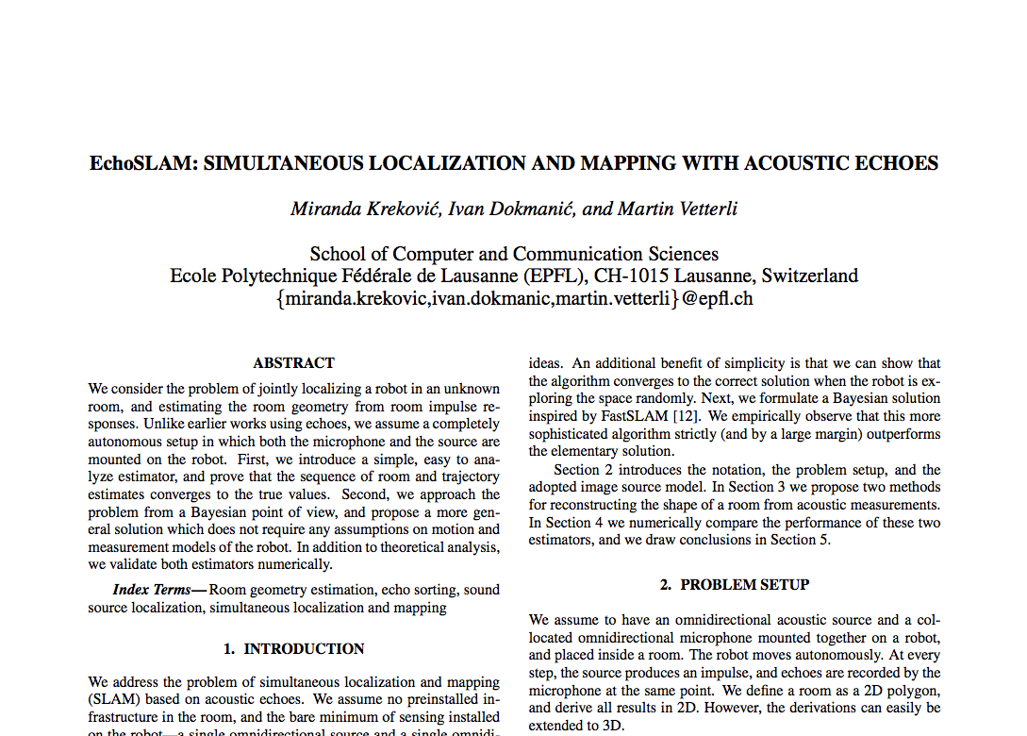
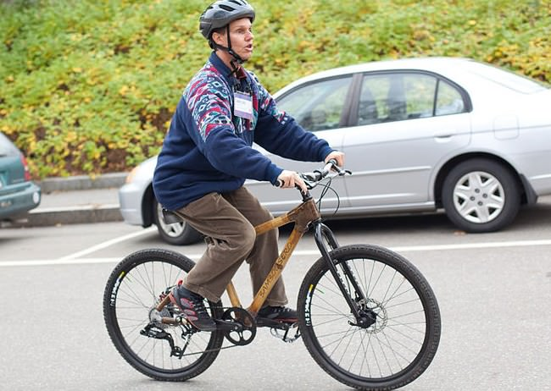
Introduction Motivation – Echolocation for Navigation
Notes:
EchoSLAM is super cool and important because...
Fig. 1: Daniel Kish, founder of World Access for the blind

Slide 3
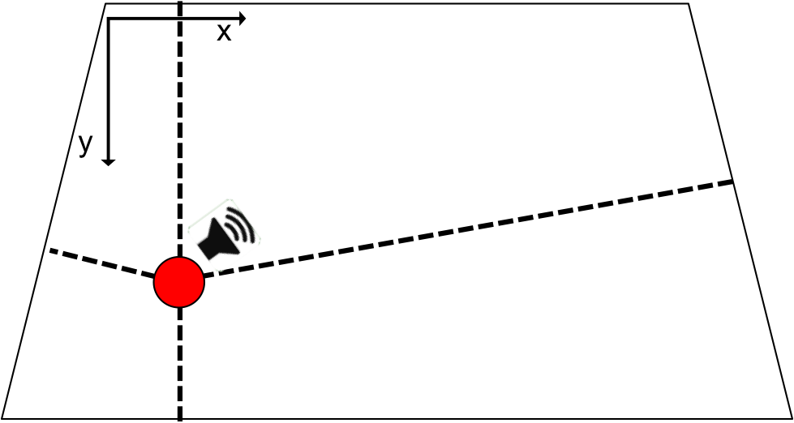
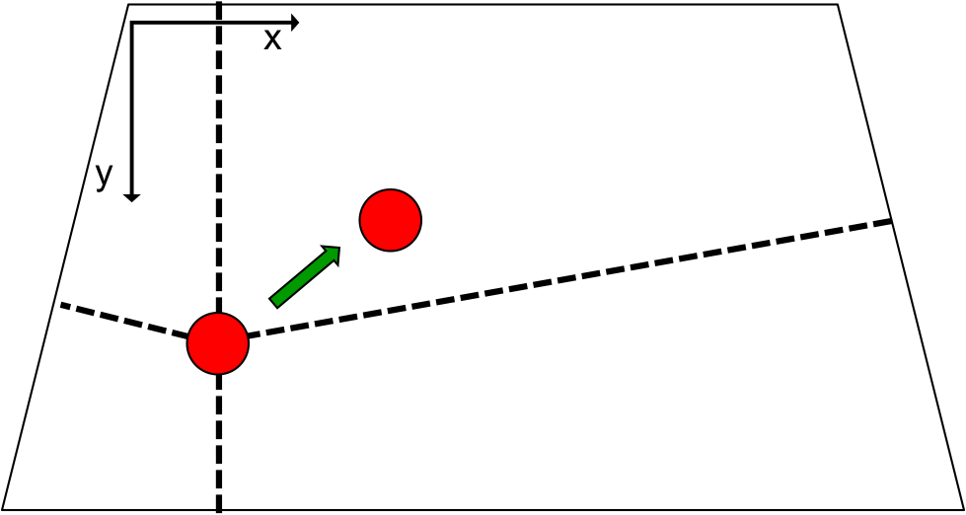
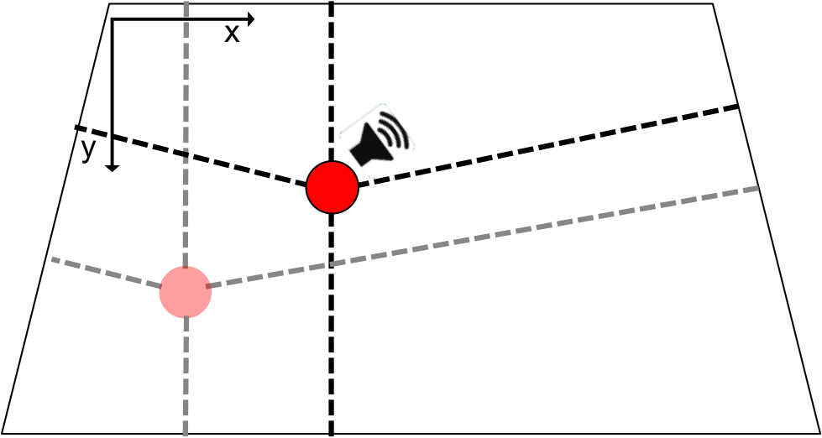
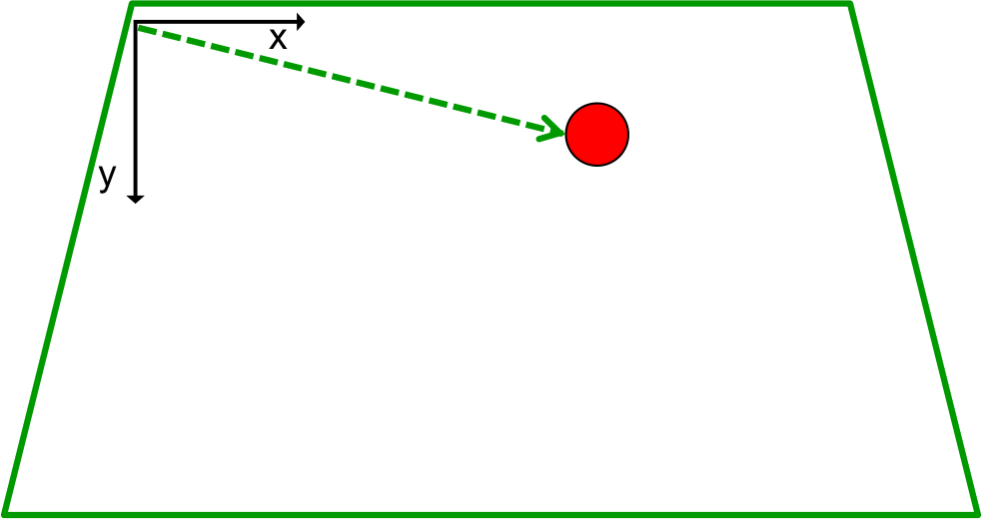
Introduction Goal – Experimental Framework
Visual localization
ground truth
Odometry
relative position
EchoSLAM
absolute position and room geometry
Notes:
Therefore we need an experimental setup.

Slide 4
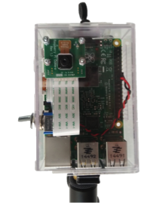
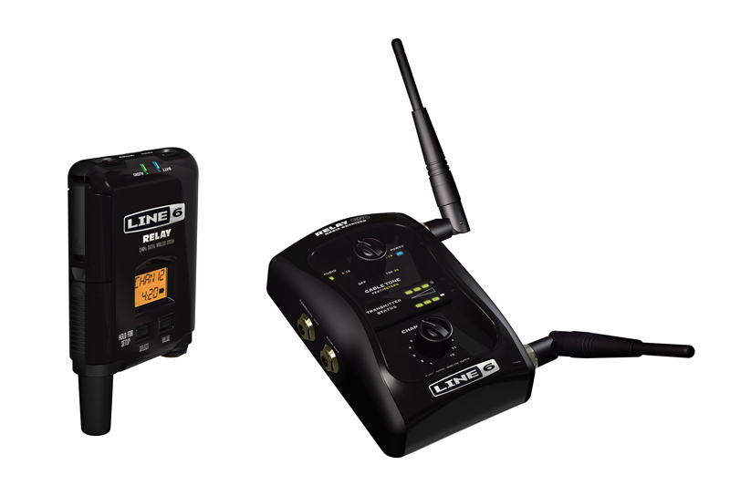
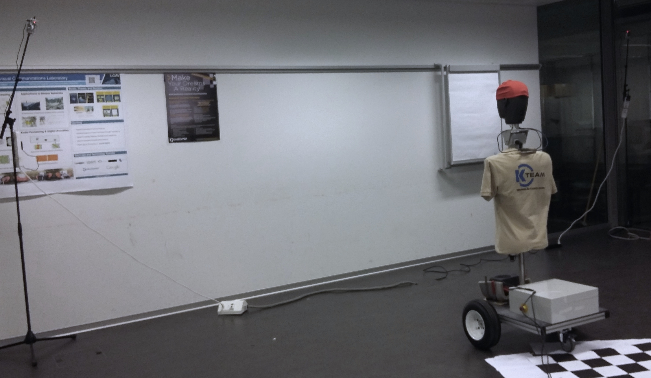
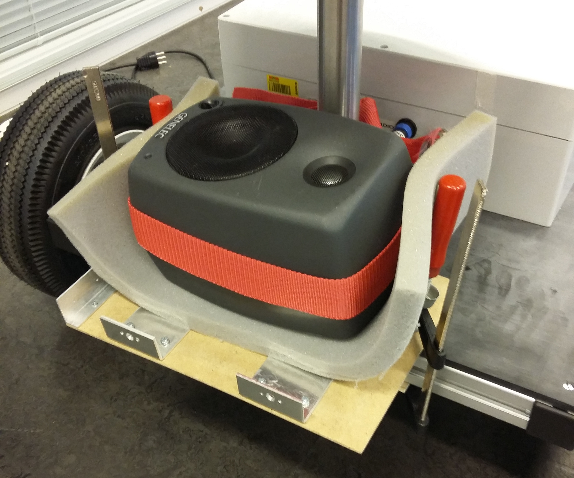
Experimental Setup Overview
EchoSLAM
absolute position and room geometry
Visual localization
ground truth
Odometry
relative position
Notes:
These are the parts the experimental setup is made of ...
... and this is how they are used in practice.

Slide 5
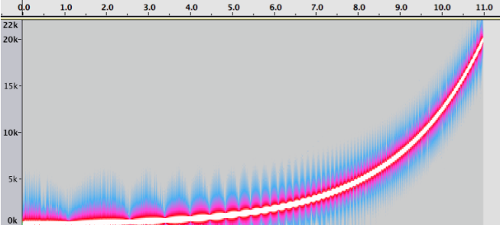
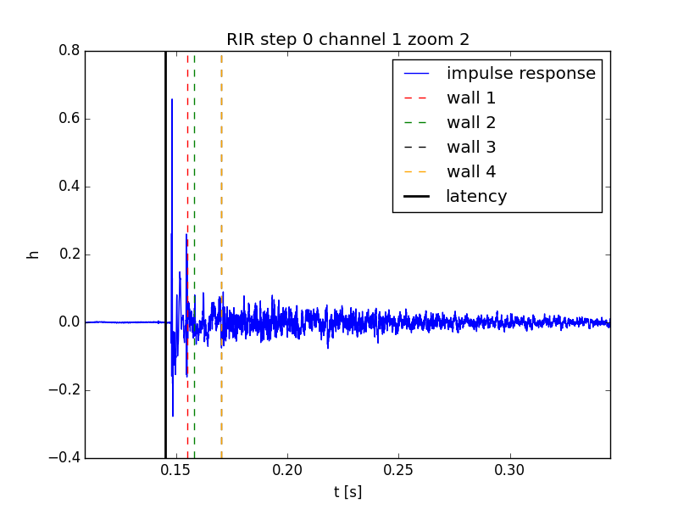
Room Impulse Response (RIR) Experimental Procedure
EchoSLAM
Visual Localization
Odometry
Fig. 1: Spectogram of sine sweep used
Fig. 2: RIR of channel 1 obtained by deconvolution
Notes:
This is a quick review of image processing for feature detection and a review of the two examples (ref points or checkerboard)

Slide 6
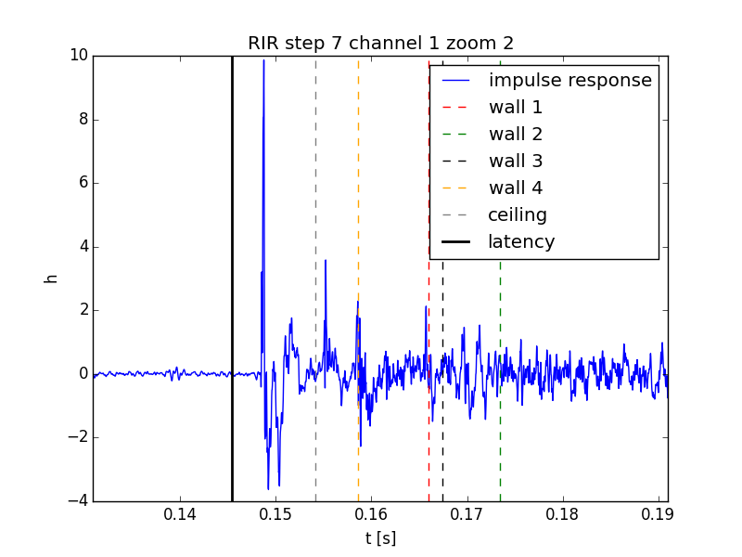
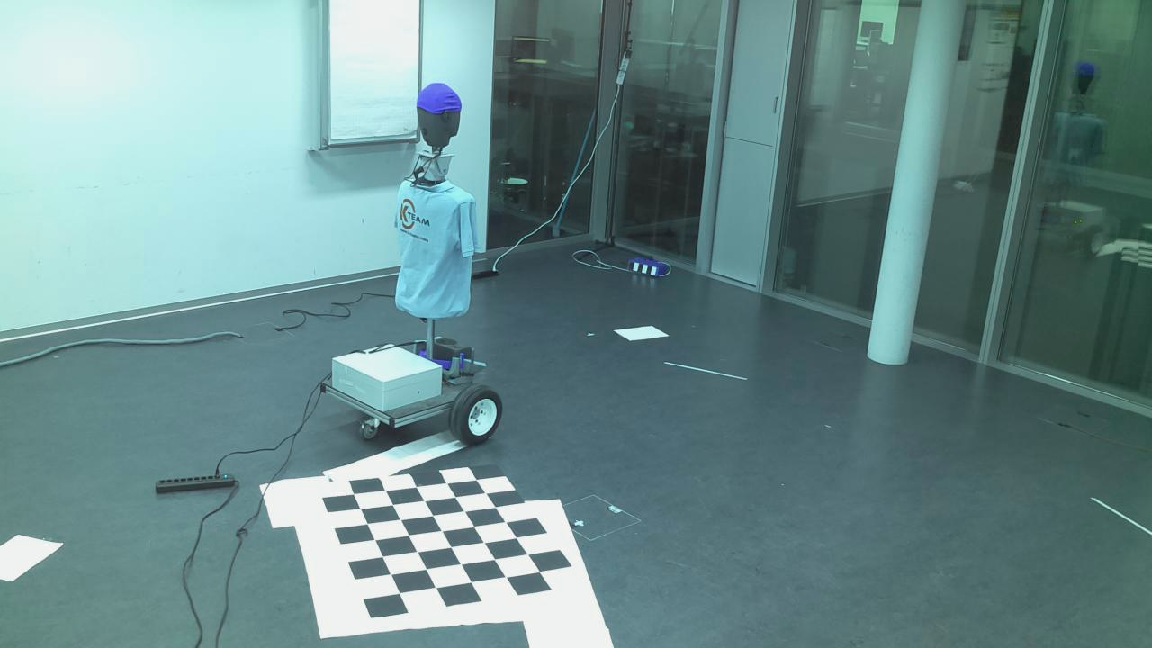
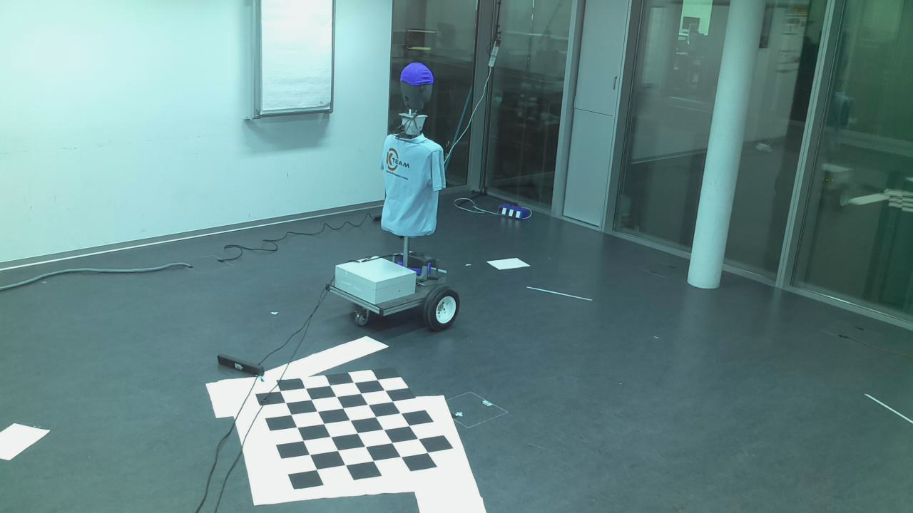
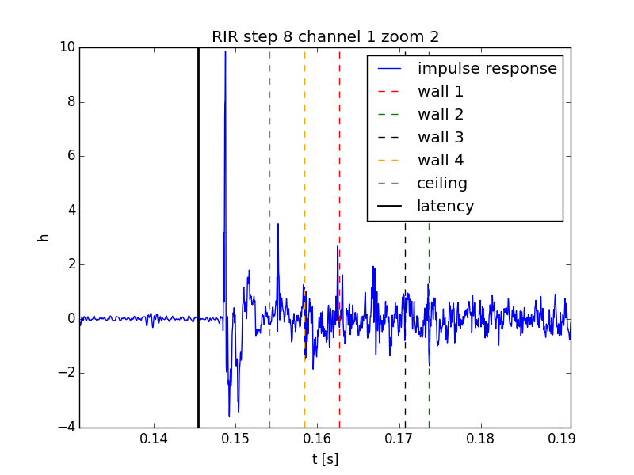
Room Impulse Response (RIR) Experimental Results
EchoSLAM
Visual Localization
Odometry
Fig. 1: RIR at position 7

Slide 7
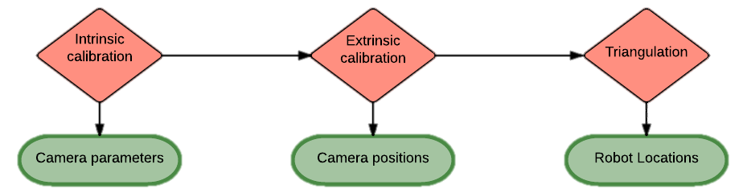
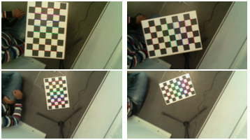
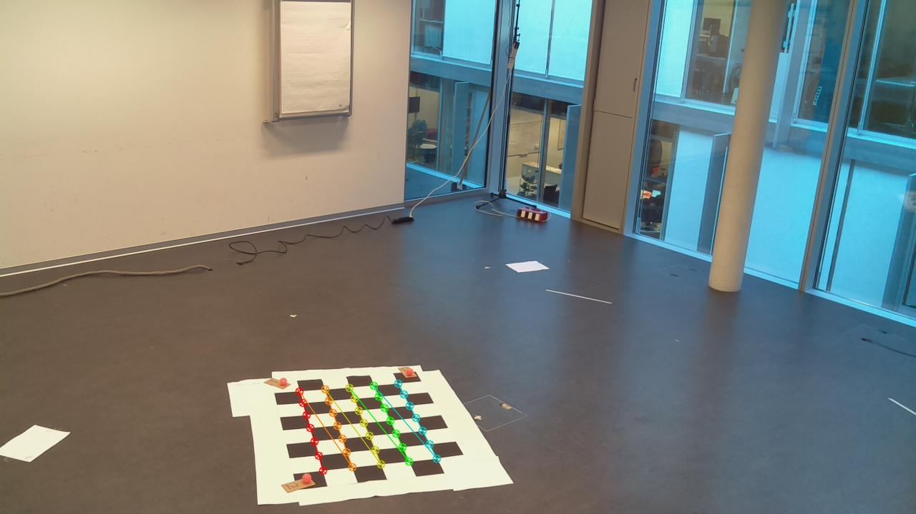
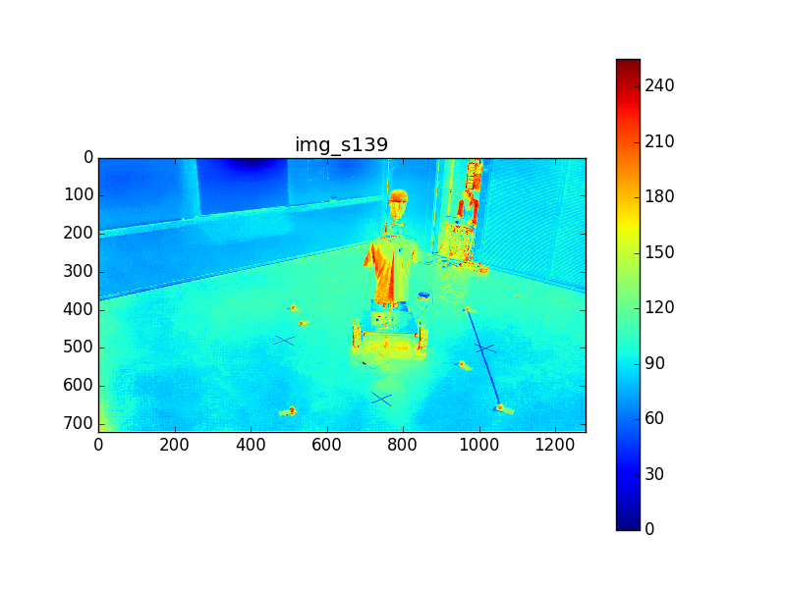
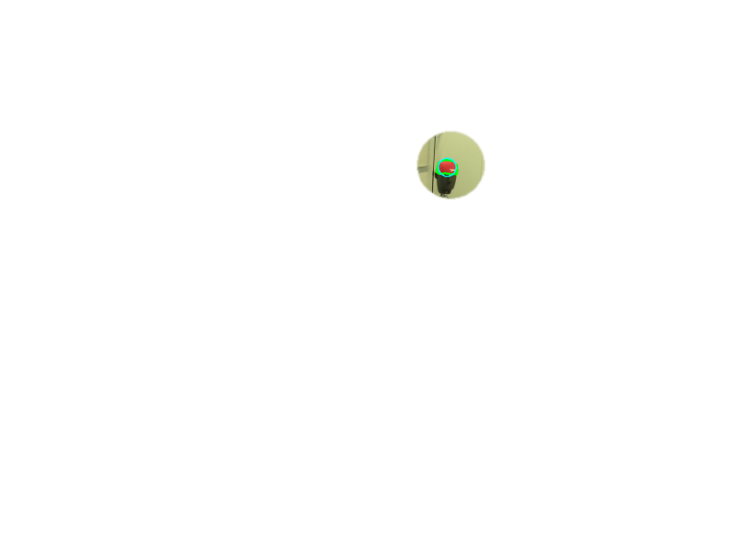
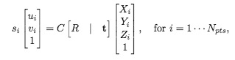
Visual Localization Experimental Procedure
EchoSLAM
Visual Localization
Odometry
given pictures of checkerboard C and distortion coeff.
given positions X, Y, Z of N_{pts} = 5 x 7 points
R, t
given (u_{j},v_{j}) for j cameras, Z optional
X, Y, (Z)
Notes:
This is a quick review of image processing for feature detection and a review of the two examples (ref points or checkerboard)

Slide 8
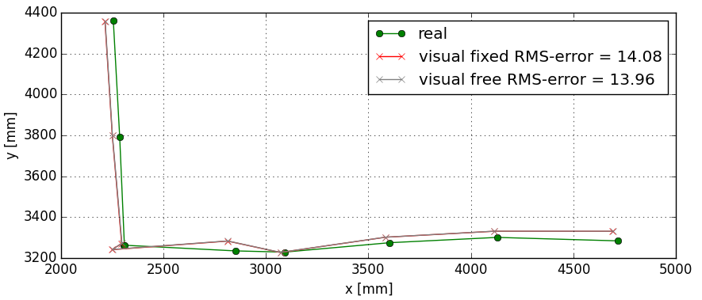
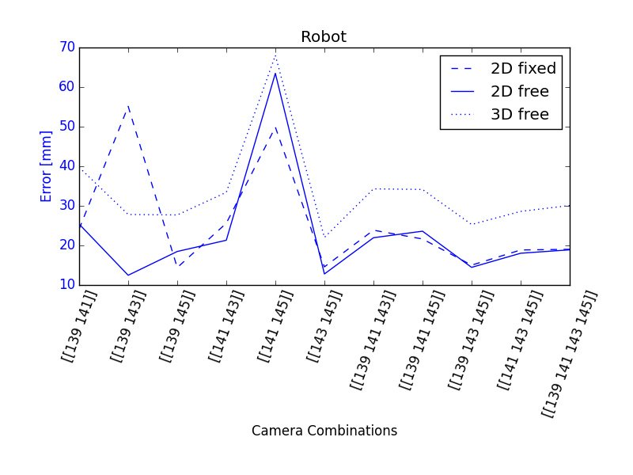
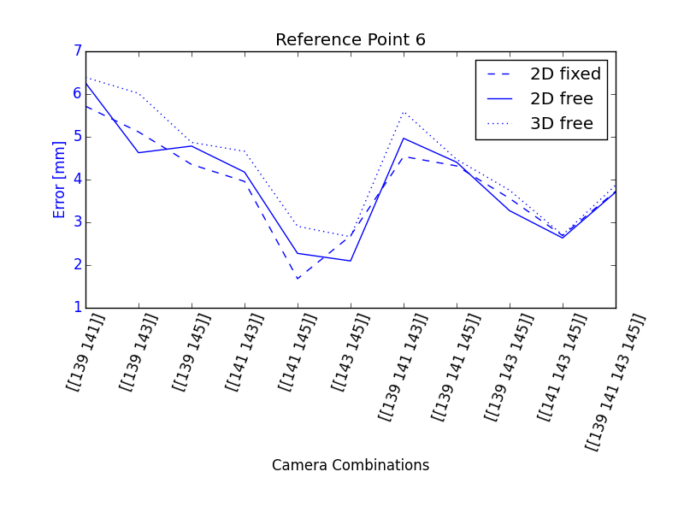
Visual Localization Experimental Results
EchoSLAM
Visual Localization
Odometry
Fig. 2: Results using all cameras
Fig. 1: Robot (top) and reference point (bottom) error
11.01.2016
Notes:
Obviously, the best measure would be the error between real and calculated. These are the idealistic (best) results
This is what we can really obtain since we don‘t know the robot‘s real position (and therefore the best combination)

Slide 9
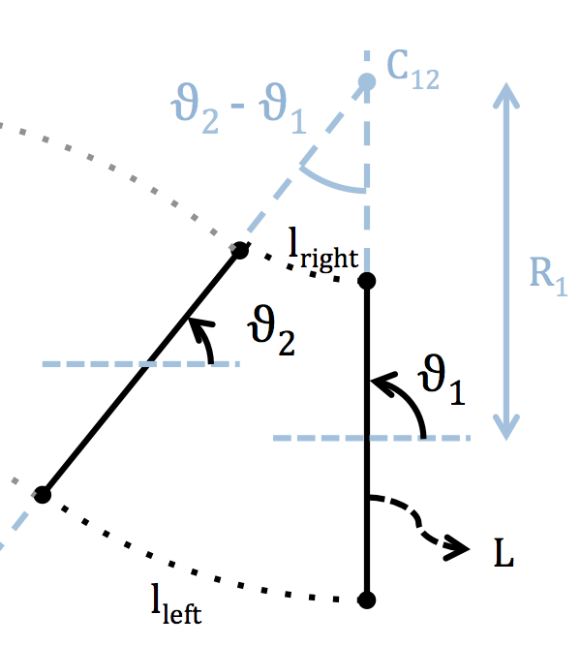
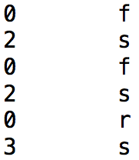
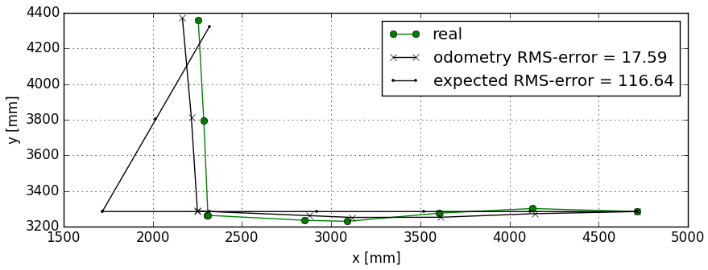
Robot Movement and Odometry Procedure and Results
EchoSLAM
Visual Localization
Odometry
Fig. 1: Command blocks
Fig. 2: Odometry geometry considerations
Fig. 3: Robot positions
Notes:
This is how unreliable the robot‘s movement is and how odometry gives a good but erronate idea of the actual movement of the robot.

Slide 10
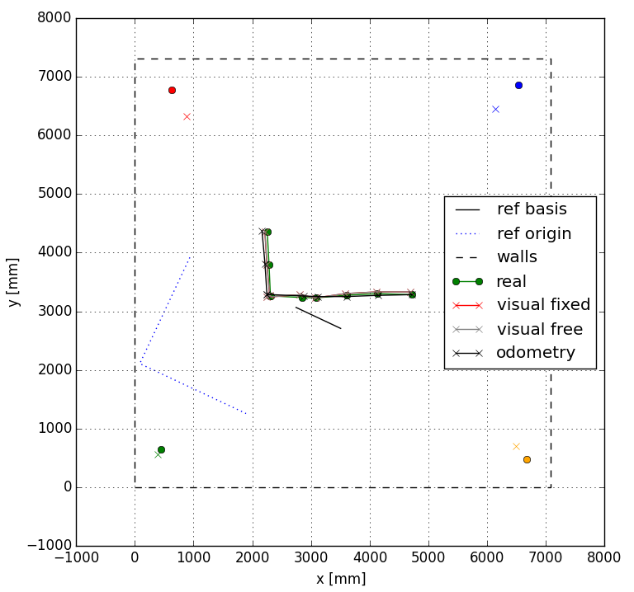
Experimental Results Summary
EchoSLAM
Visual Localization
Odometry
Fig. 1: Results using all cameras in room reference
Notes:
This is a summary of the realistically obtained precision.

Slide 11
Conclusion Achievements
Experimental framework (both Hardware and Software) tested and validated
Visual localization with precision up to 1 cm
Odometry analysis implemented
Room impulse response recording and deconvolution working
Setup instructions and code documentation available online for later use

Slide 12
Conclusion Suggested Improvements
Smaller or more accurate target point for visual localization (checkerboard / QR code)
Add fisheye lenses for wider views
More robust robot movement and audio control
Improve signal processing for reliable echolocation (e.g. averaging)

Slide 13
Thank you

Slide 14
Experimental Setup Visual Localization Procedure
Governing equation
C and distortion coefficients obtained by intrinsic calibration
Two different cases are treated:
Positioning of cameras (R, t) based on image-object space correspondances
Localization of point given its image in 4 cameras.
Minimization of reprojection error
Notes:
This is a quick review of image processing for feature detection and a review of the two examples (ref points or checkerboard)

